Slide 1


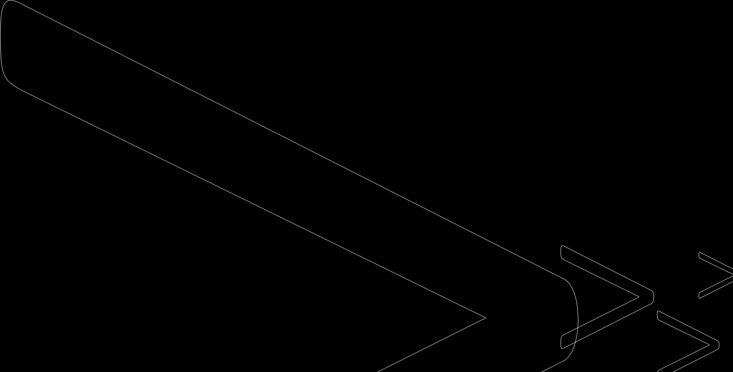
For Loop
The for loop is used for frequently , usually where the loop will be traversed a fixed number of times in a range function.
Syntax:
for initialization in range(value):
Statement
For ex:
For I in range(5):
Print(I)

Slide 2
for loops are used when you have a block of code which you want to repeat a fixed number of times.it no of iterates over the members of a sequence in order.
It range function also work as increment and deceremt type.
For loop working

Slide 3
Nested For Loop
Inside for loop a loop
Syntax: for intalization1 in range(value): for intaliation2range(value2): for intalization3 in range(value3):

